Slide 1
Final Project
Jarrod Pearman
COP 5611

Slide 2
Implement my Own Shell

Slide 3
Environment
Ubuntu Virtual Machine using Virtual Box
Coded in C
Ran in Linux Terminal
GitHub: https://github.com/PearmanJ/MyShellProgram.git

Slide 4
Overview
For my project I wanted to create my own shell in order to test my ability at implementing a useable interface.
The main goal was to implement my own version of the “|” pipes operator.
The “|” pipe operator takes the output of one command and sends it to another command as its input.
Syntax: “cat test.txt | head -4”
Connect and pipe 2 commands together.

Slide 5
Minimum Features
Implement parser and interpreter for command line input from user.
Core component of shell as it handles all user interaction.
Implement basic pipes in order to make to take output from one command as input to another command (“|”). Support for two commands.
Ensure that most basic Linux commands can be executed.
Ensure piped commands can be executed.
Implement basic shell interface.
Implement “help” command.

Slide 6
Extra Goals and Features (if time persisted)
Implement pipes on multiple connected commands, use multiple “|”.
Have support for piping more than 2 commands.
Implement “time” flag to track a commands completion time and output the time after the commands output.
Implement a History Buffer to show the most recent commands.
Allow the user to execute commands in the history buffer.
If time persist implement my own version of useful commands and features.

Slide 7
Features I Implemented
Execute basic Linux commands.
Execute Pipes on two commands, along with pipes on multiple commands.
History Buffer that allows the user to view recent history and execute commands in history.
Time flag to see commands completion time.
Help command to see built-in commands.
Type “exit” to close shell.

Slide 8
Key C Functions Used to Execute and Pipe Commands
execvp()
Execute the given command
2 parameters – execvp(<the command>, <array of command attributes>);
Ex.) execvp(command[0],command);
Fork()
Execute the commands as a child process’s.
For Pipes:
Create Pipe:
int fd[2] //fd[0] read end , fd[1] write end
Pipe(fd)
Dup2()
Reroute data to and from the pipe, duplicate fd[x]
Close()
Used to close write and read ends of pipe when pipes not in use.

Slide 9
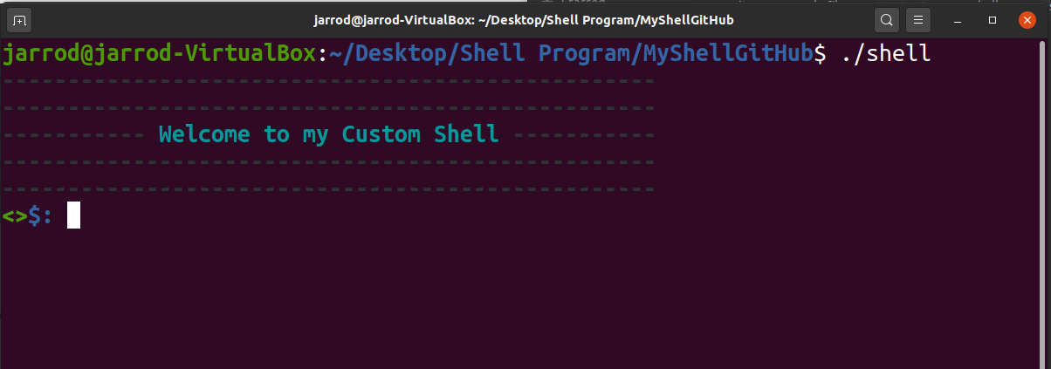
Compile and Run Shell.
Compiled with a makefile using “make”
Run using “./shell”

Slide 10
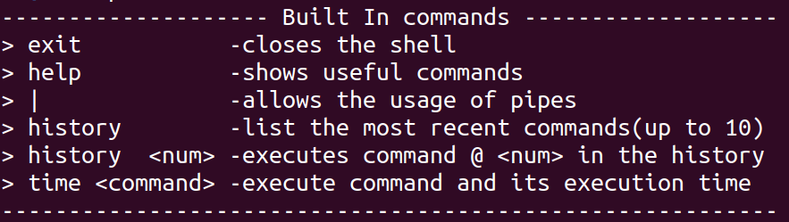
Built-In Commands
Shown if you type: “help”

Slide 11
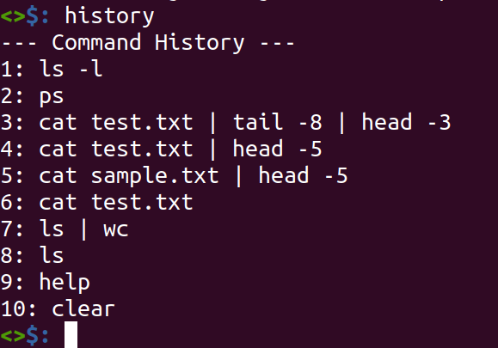
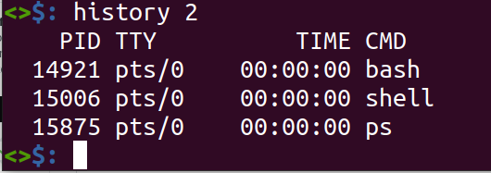
Built-In Commands
Shown if you type: “history”
If you type “history <num>” it will execute command at that point in history.

Slide 12
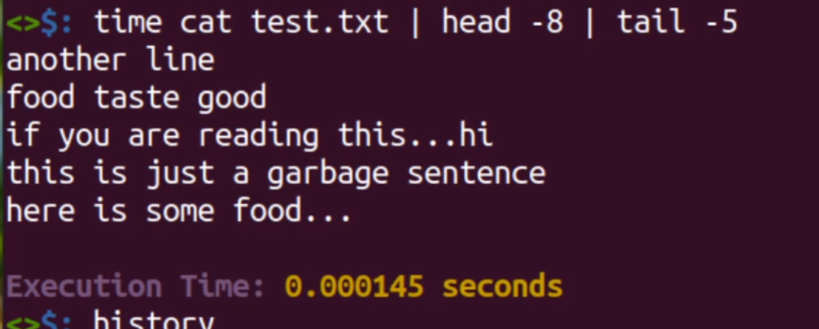
Built-In Commands
Shown if you type: “time <command>”

Slide 13
Demo

Slide 14
THE END

